Slide 1
Data Reduction and Analysis Techniques
Ronald J. Maddalena
www.nrao.edu/~rmaddale/Education

Slide 2
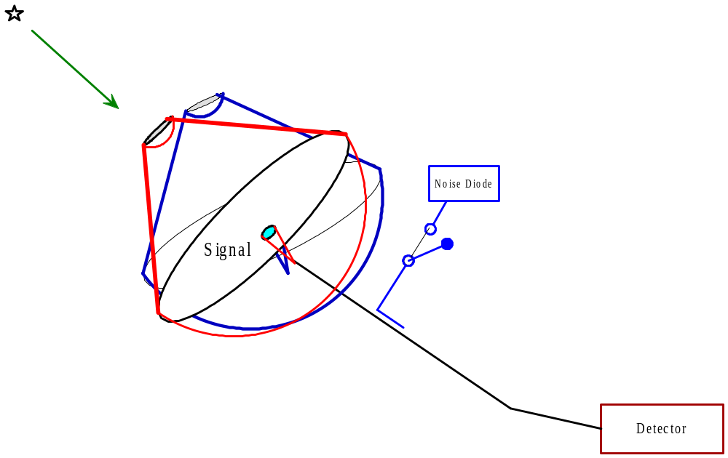
Continuum - Point Sources
On-Off Observing
Observe blank sky for 10 sec
Move telescope to object & observe for 10 sec
Move to blank sky & observe for 10 sec
Fire noise diode & observe for 10 sec
Observe blank sky for 10 sec

Slide 3
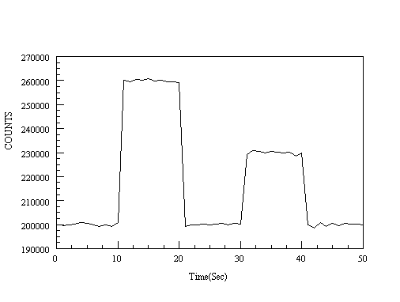
Continuum - Point Sources
On-Off Observing

Slide 4
Continuum - Point Sources
On-Off Observing
Known:
  Equivalent temperature of noise diode or calibrator (T_{cal}) = 3 K
  Bandwidth (Δν) = 10 MHz
  Gain = 2 K / Jy
Desired:
  Antenna temperature of the source (T_{A})
  Flux density (S) of the source.
  System Temperature(T_{s}) when OFF the source
  Accuracy of antenna temperature (σ _{TA})

Slide 5
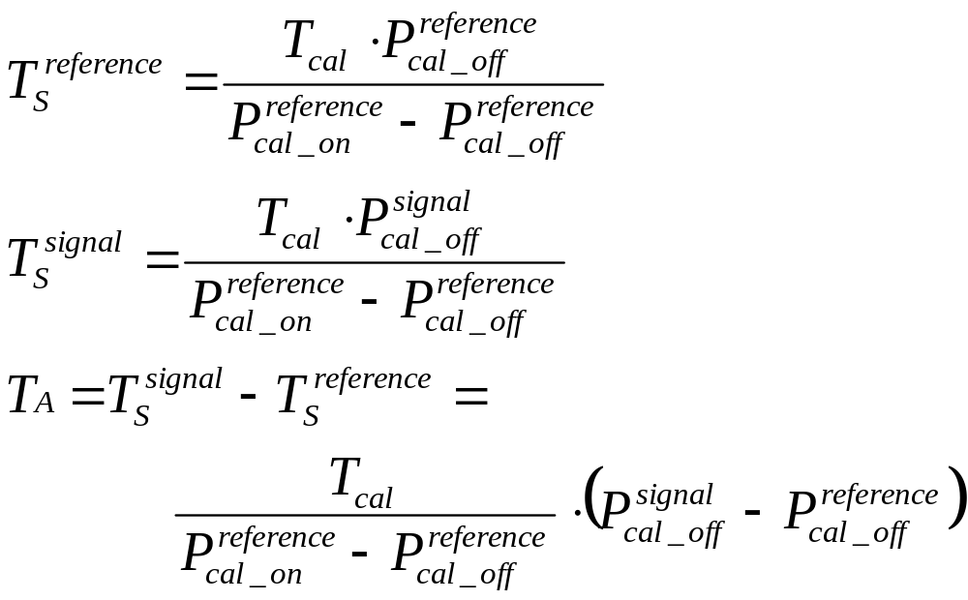
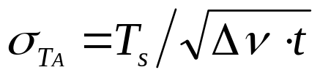
Continuum - Point Sources
On-Off Observing
20 K
26 K
6 K
0.002 K
SNR = 3000

Slide 6
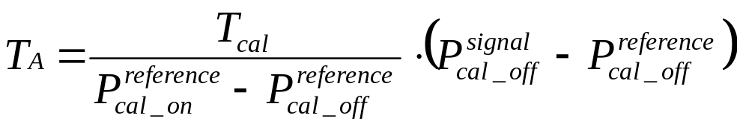
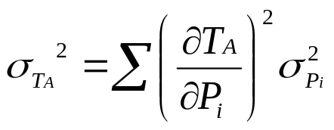
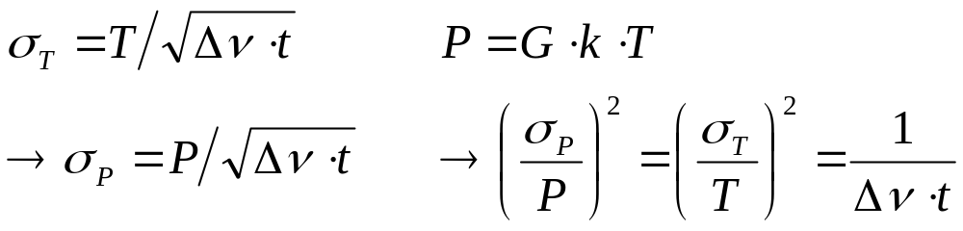
Continuum - Point Sources
On-Off Observing –noise estimate
1. Write down data analysis equation:
2. Use “propagation of errors”:
3. Use the following substitutions :

Slide 7

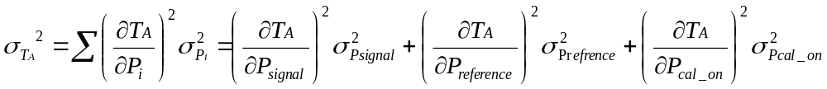
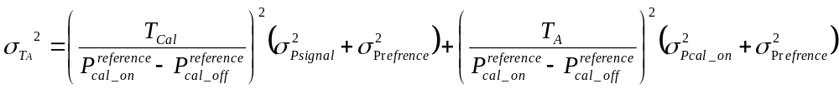
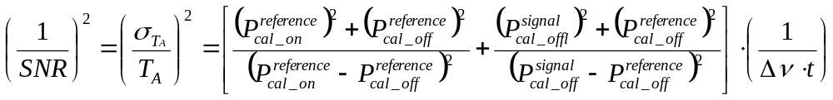
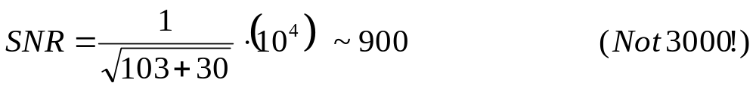
Continuum - Point Sources
On-Off Observing – noise estimate

Slide 8
Continuum - Point Sources
Assumptions:
“Classical” Radiometer equation assumes:
Narrow bandwidths,
Linear power detector,
T_{A} << T_{s},
Noise diode temperature << T_{s},
t^{reference} = t^{signal}
t_{cal_on} = t_{cal_off}
Blanking time << t^{signal}
No data reduction!

Slide 9
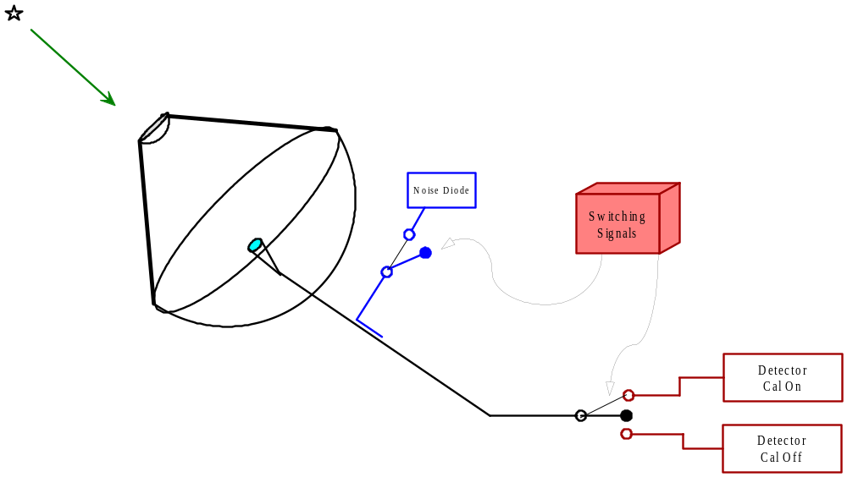
Phases of an Observation
Total Power

Slide 10
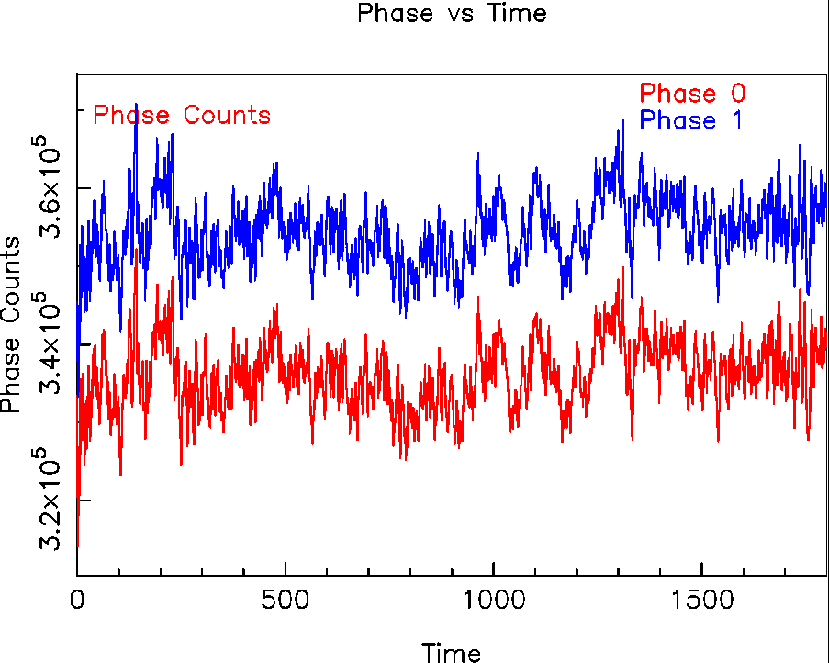
Phases of an Observation
Total Power
Tcal = 4 K
Ts = 100 K
-------------
σ_{theor} =0.1 K
σ_{meas} =1 K
-------------
Shapes very similar
Excess noise from atmospheric fluctuation

Slide 11
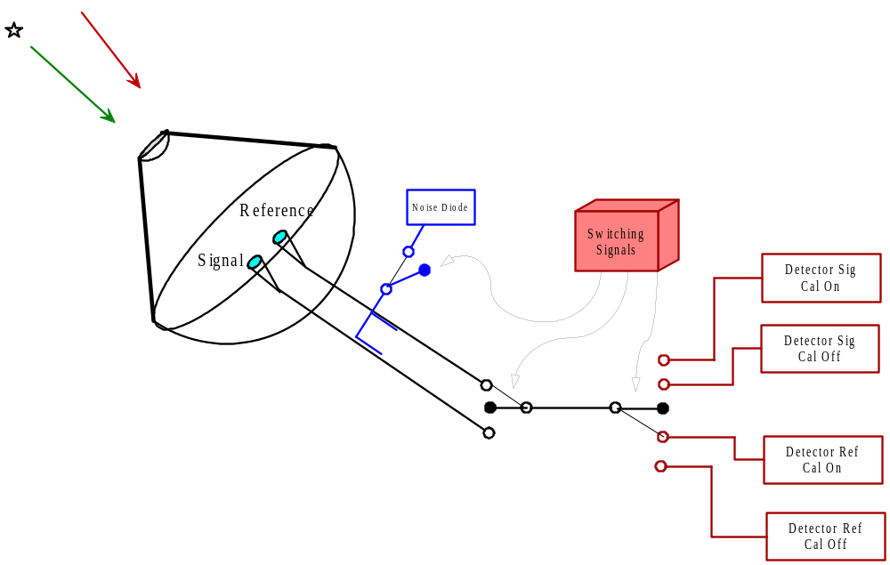
Phases of a Observation
Beam Switched Power

Slide 12
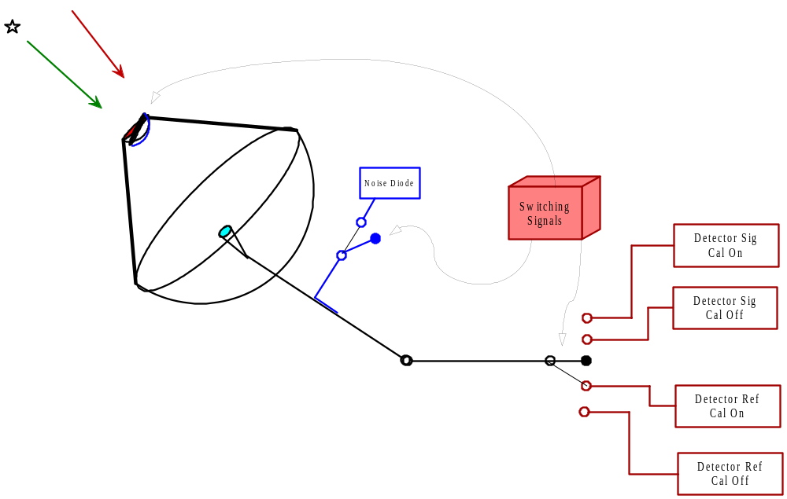
Phases of a Observation
Beam Switched Power

Slide 13
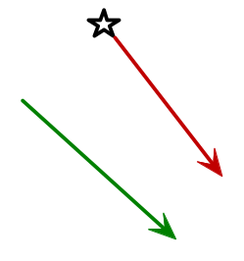
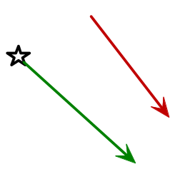
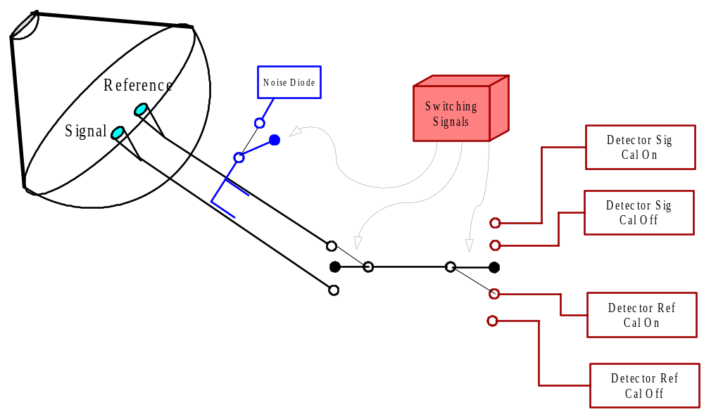
Phases of a Observation
Double Beam Switched Power

Slide 14
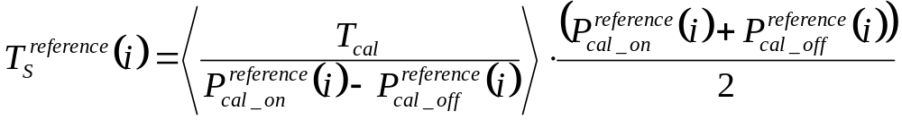
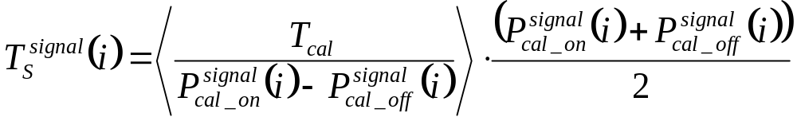
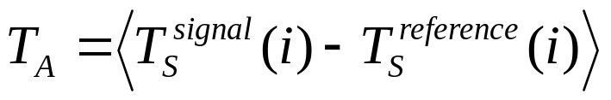
Continuum - Point Sources
Beam-Switched Observation

Slide 15
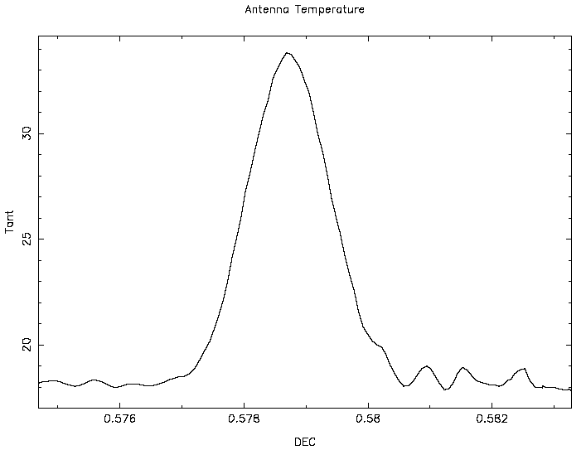
Continuum - Point Sources
On-The-Fly Observation
Beamwidth
T_{A}
Position
Ts

Slide 16
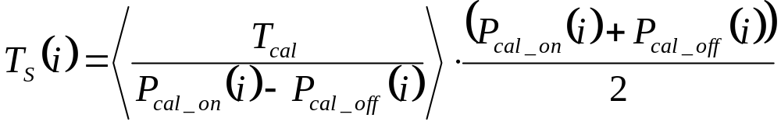
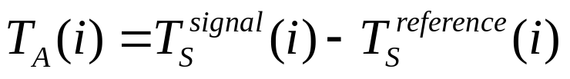
Continuum - Point Sources
On-The-Fly Observation
If total power:
If beam-switching (switched power):

Slide 17
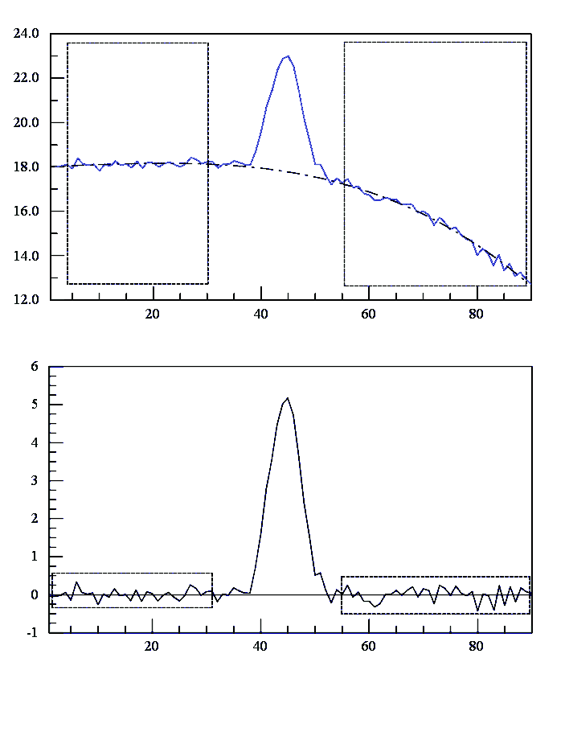
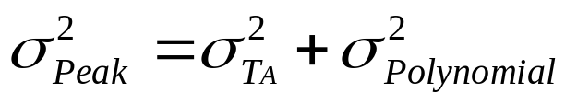
Baseline Fitting
Polynomials
Set order of polynomial
Define areas devoid of emission.
---------------------------
Creates false features
Introduces a random error to an observation
Why Polynomials?

Slide 18
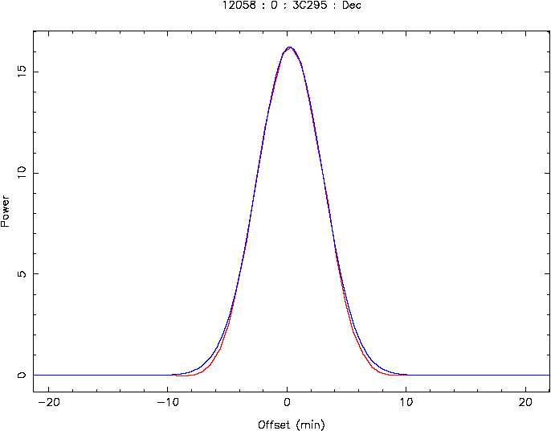
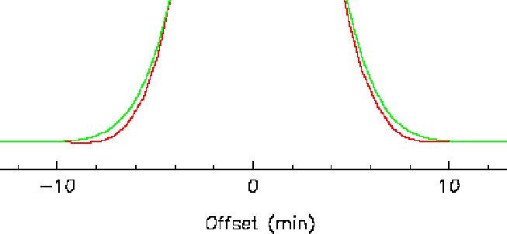
Continuum - Point Sources
Gaussian Fitting
Define initial guesses
Set flags to fit or hold constant each parameter
Set number of iterations
Set convergence criteria
----------------------------
Fitted parameters
Chi-square of the fit
Parameter standard deviations.
----------------------------
Restrict data to between the half power points for fitting to a telescope’s beam
Multi-component fits should be done simultaneously

Slide 19
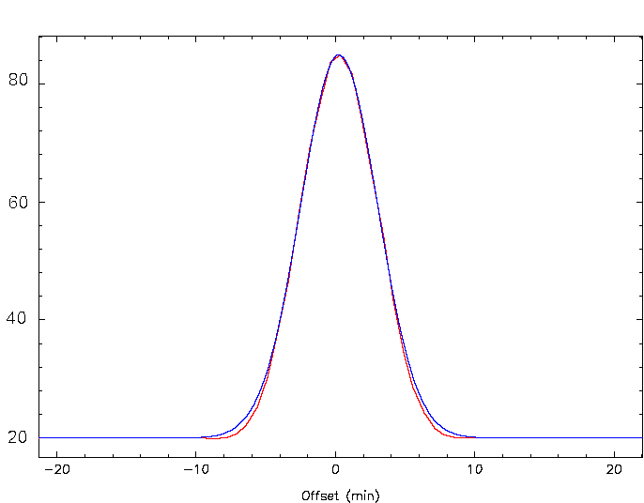
Continuum - Point Sources
Gaussian Fitting
Where is noise the highest?
Where is noise the lowest?
σ changes across the observation.
Weights (1/ σ²) for least-square-fit changes across the observation.
For strong sources, should worry about using proper weights in data analysis.

Slide 20
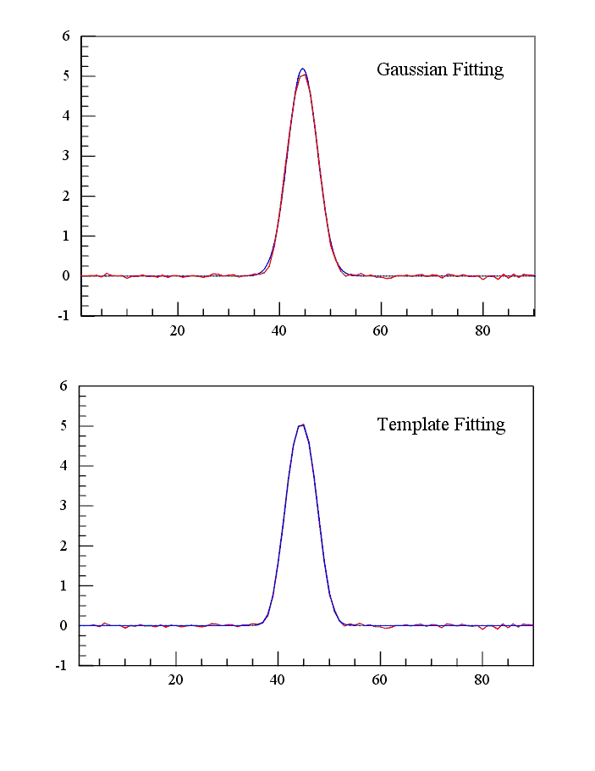
Template Fitting
Create a template:
  Sufficient knowledge of the telescope beam, or
  Average of a large number of observations.
---------------
Convolve the template with the data => x-offset.
Shift by the x-offset.
Perform a linear least-squares fit of the template to the data:
Always try to fit physically-meaningful functions

Slide 21
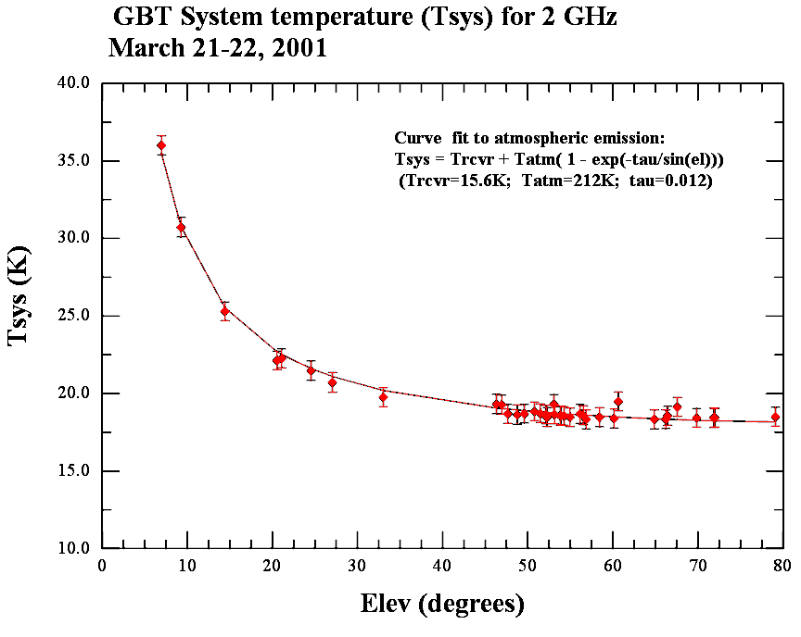
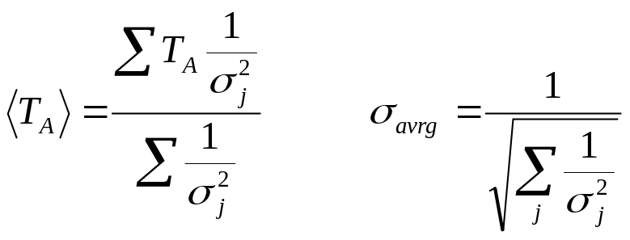
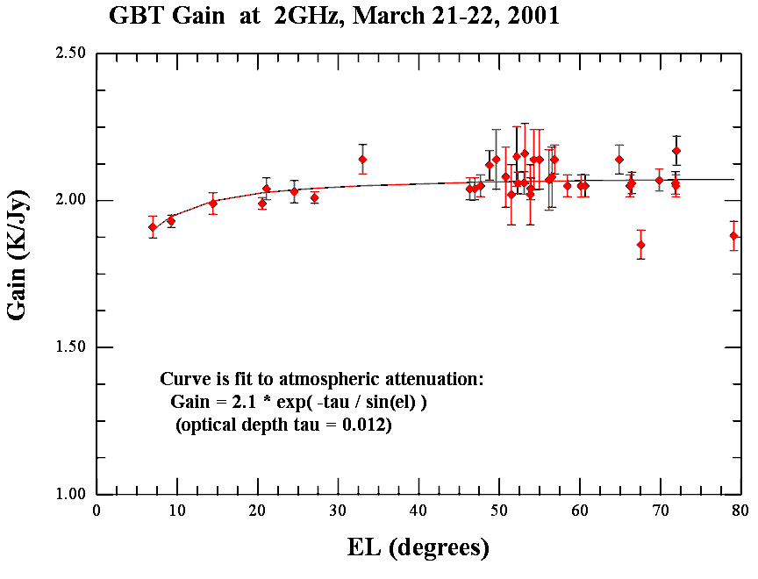
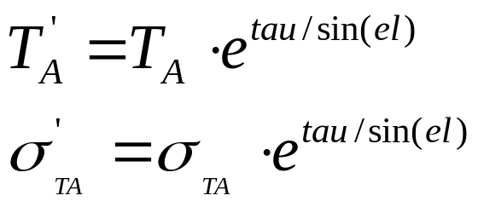
Averaging Data / Atmosphere
T_{s} changes due to atmosphere emission.
Use weighted average with weights = 1/σ²
T_{A} changes due to atmosphere opacity.
Opacity from the literature or theory, from a tipping radiometer, from atmospheric vertical water vapor profiles, or by “tipping” the antenna

Slide 22
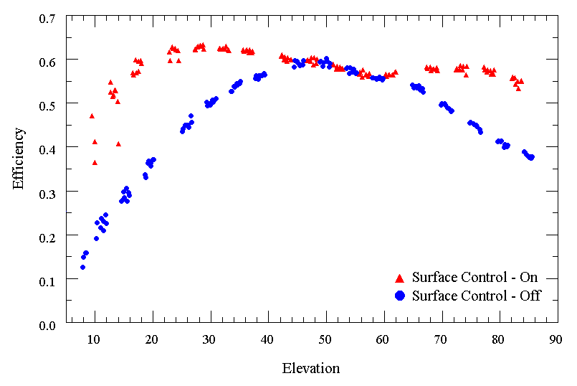
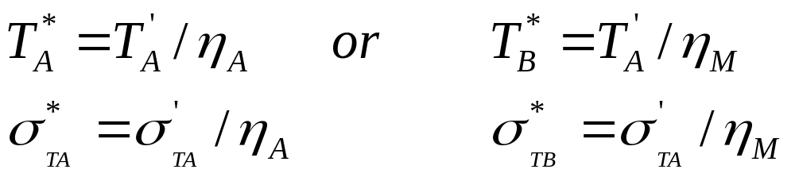
Gain Correction

Slide 23
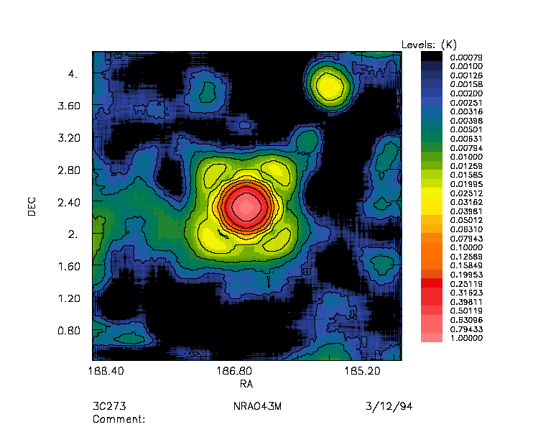
Continuum - Extended Sources
On-The-Fly Mapping
Telescope slews from row to row. Row spacing: ~0.9λ/2D
A few samples /sec.
Highly oversampled in direction of slew <0.3λ/2D
Could be beam switching
----------------------
Convert Power into T_{S}.
Fit baseline to each row?
Grid into a matrix

Slide 24
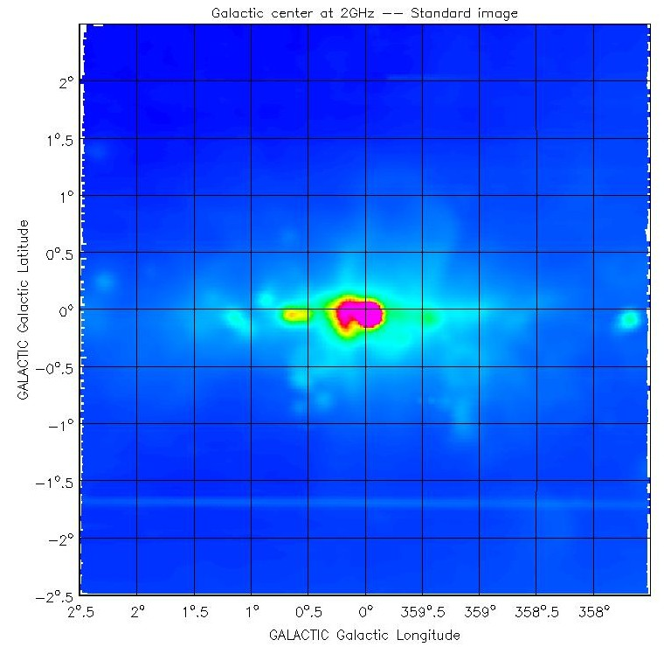
Continuum - Extended Sources
On-The-Fly Mapping - Common Problems
Striping (Emerson 1995; Klein and Mack 1995).
If beam-switched, Emerson, Klein, and Haslam (1979) to reconstruct the image.
Make multiple maps with the slew in different direction.

Slide 25
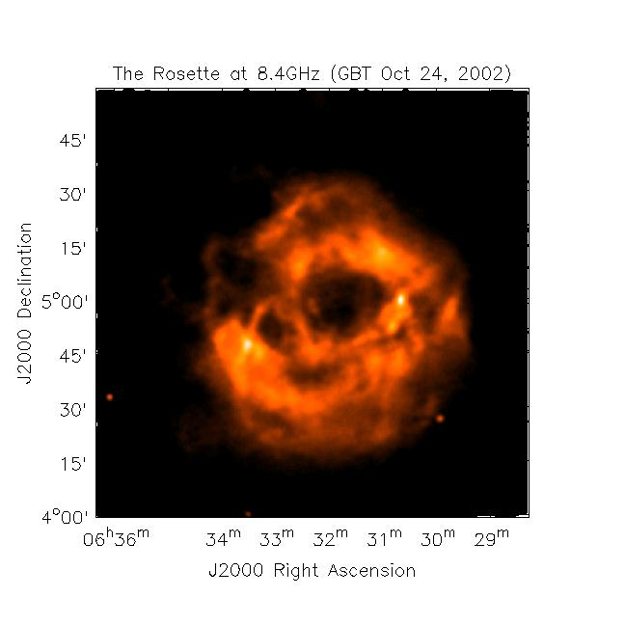
GBT Continuum Images – Rosette

Slide 26
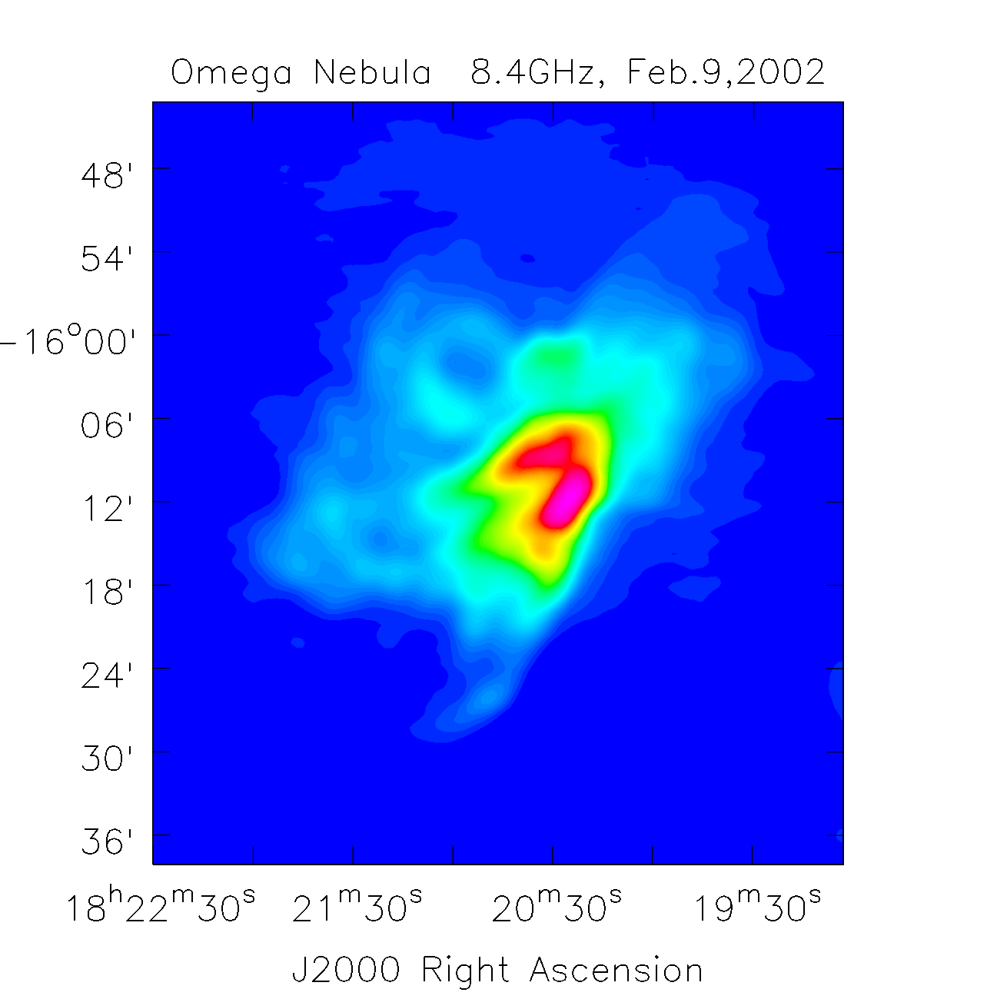
GBT Continuum Images – M17

Slide 27
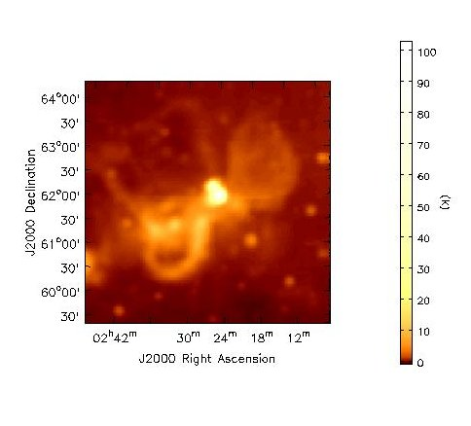
GBT Continuum Images – W3

Slide 28
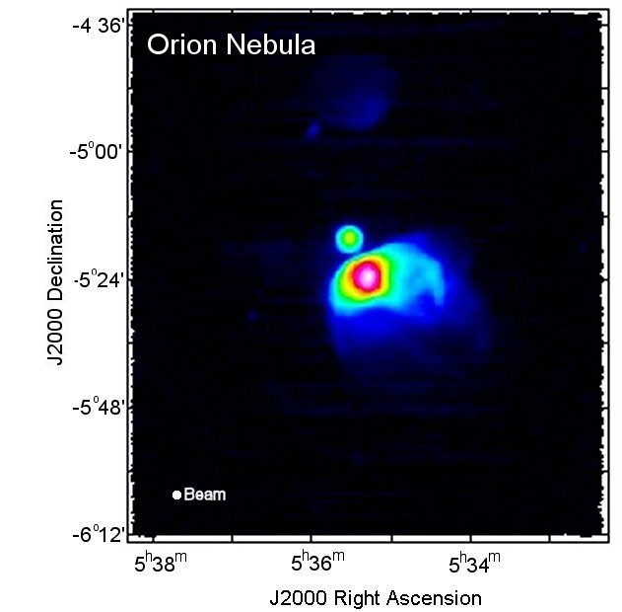
GBT Continuum Images - Orion

Slide 29
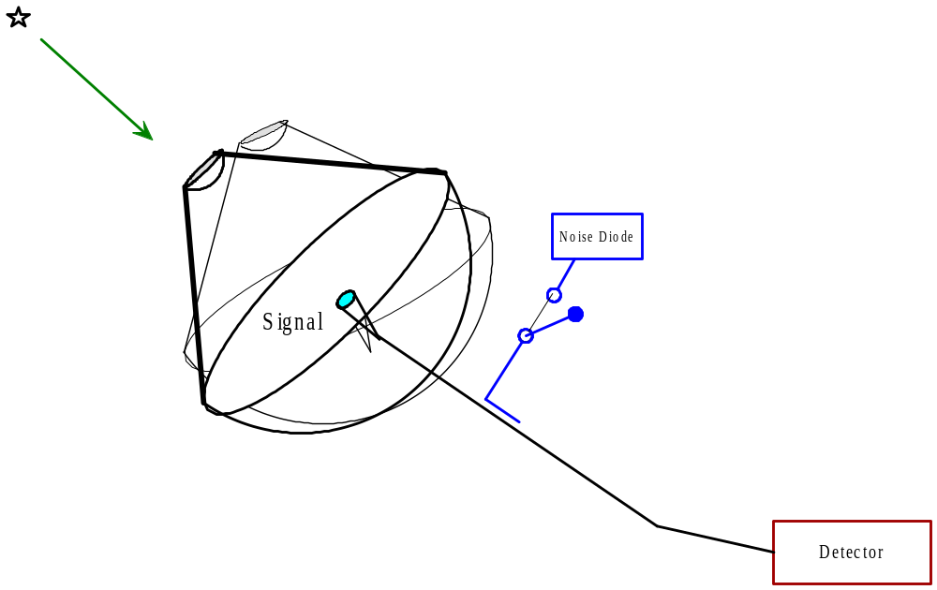
Spectral-line - Point Sources
On-Off Observing
Observe blank sky for t_{reference} sec
Fire noise diode to determine T_{s}
Move telescope to object & observe for t_{signal} sec
Can observe an extended source using this technique -- ‘signal’ observations arranged in a “grid” map.

Slide 30
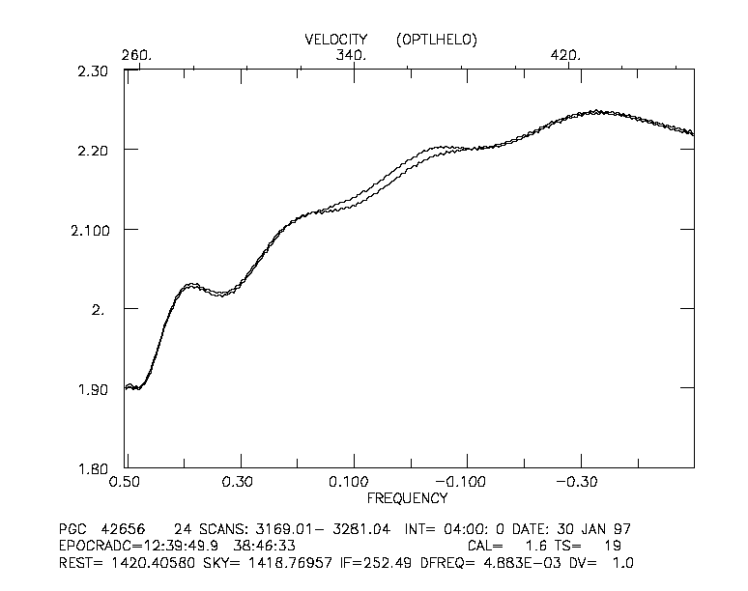
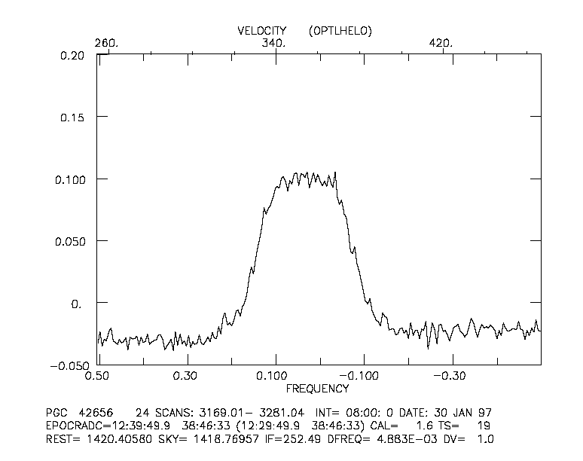
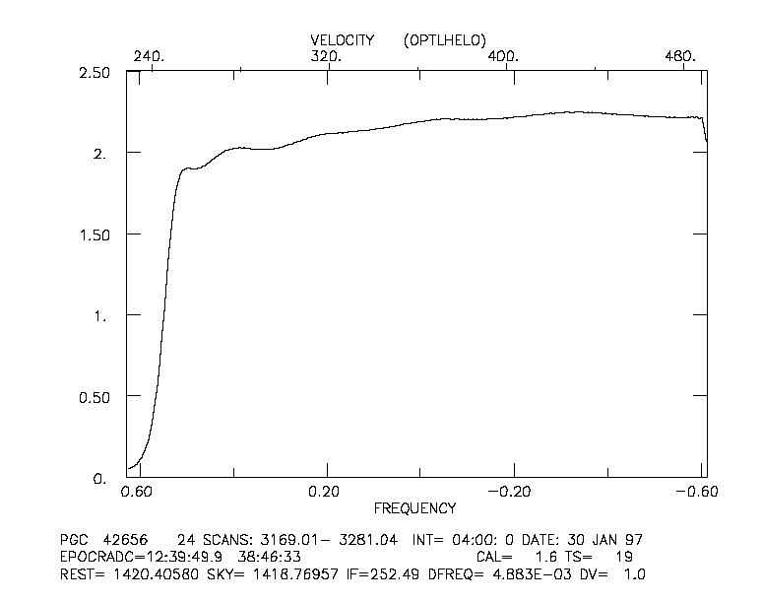
Spectral-Line - Point Sources
Position-Switched Observing

Slide 31
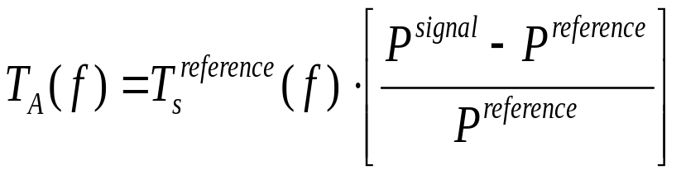
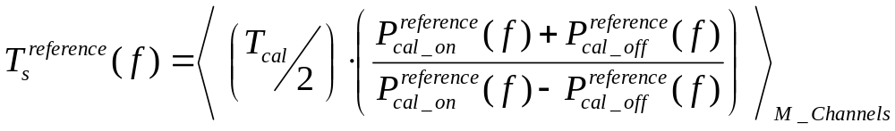
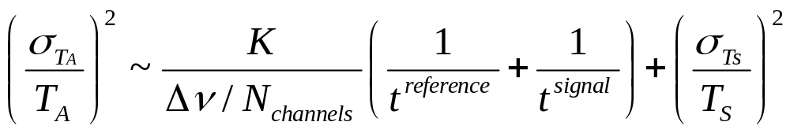
Spectral-Line - Point Sources
Position-Switched Observing
Smoothed/Averaged
T_{s} of Denominator
Signal
(line expected)
Reference
(No line expected)
But only for weak lines and no strong continuum!
Constant depends upon details of the detecting backend

Slide 32
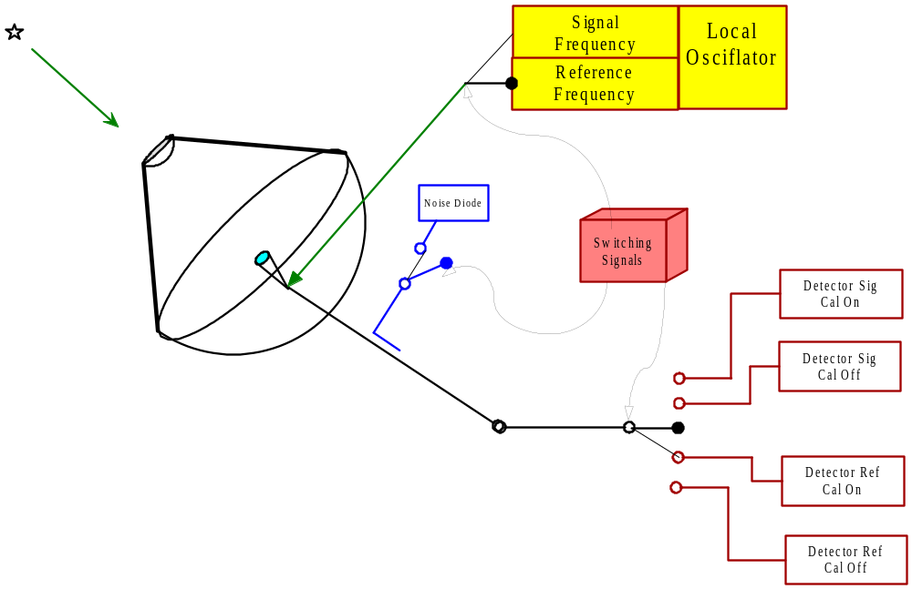
Phases of a Observation
Switched Power – Frequency Switching

Slide 33


Spectral-Line - Point Sources
Frequency-Switched Observing - In band
T_{A} = T_{s} (REF)*[(SIG-REF)/REF]
“Signal”
“Reference”
Line appears twice – should be
able to ‘fold’ the spectra to
increase SNR

Slide 34



Spectral-Line - Point Sources
Frequency-Switched – “Folding” In Band

Slide 35

Spectral-Line
Baseline Fitting
Polynomial: same as before
Sinusoid

Slide 36
Spectral-Line
Other Algorithms
Velocity Calibration
Velocity/Frequency Shifting & Regriding
  Doppler tracking limitations
Smoothing – Hanning, Boxcar, Gaussian
  Decimating vs. non-decimating routines
  For “Optimal Filtering”, match smoothing to expected line width
Filtering – low pass, high pass, median, …
Moments for Integrated Intensities; Velocity centroids, ….

Slide 37

Spectral-Line
RFI Excision

Slide 38
Spectral-Line Mapping
Grid or On-the-Fly
DEC
Velocity
RA

Slide 39


Spectral-Line Mapping
Grid and On-the-Fly
(If V1=V2 => Channel Map)
Velocity
For {v=vmin} {v <=vmax} {v++} {
if T(α,δ,v) > Tmin then
W(α,δ)=W(α,δ)+ T(α,δ,v)
endif
endfor
DEC
RA

Slide 40


Spectral-Line Mapping
Grid and On-the-Fly
Velocity
(Position-velocity map)
DEC
RA

Slide 41


Spectral-Line Mapping

Slide 42
The Future of Single-Dish Data Analysis
Increase in the use of RDBMS.
Support the analysis of archived data.
Sophisticated visualization tools.
Sophisticated, robust algorithms (mapping).
Data pipelining for the general user.
Automatic data calibration using models of the telescope.
Algorithms that deal with data sets.
Analysis systems supported by cross-observatory groups
More will be done with commercial software packages

